Slide 1
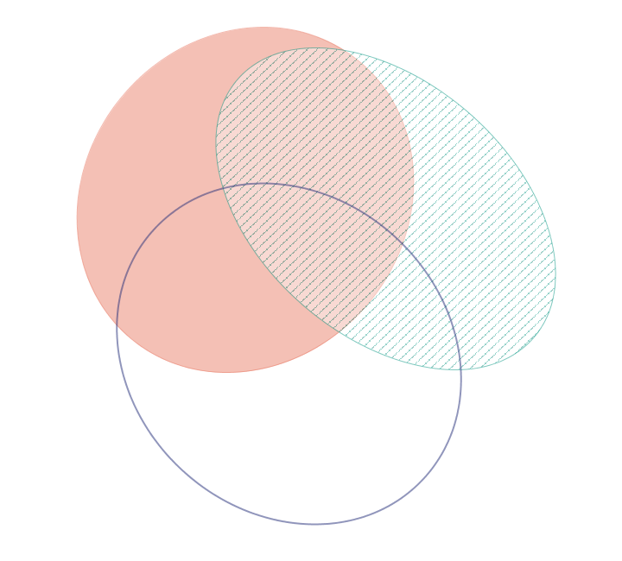
400 µatm vs. 400 µatm + Mech. Stress
400 µatm vs. 2800 µatm
79
82
93
48
75
25
138
2800 µatm vs. 2800 µatm + Mech. Stress

